Slide 1


Classifying Dog Whistles with Word Embeddings & LLMs
Sam COhen

Slide 2
What do These Mean?
26 + 6 = 1
WWG1WGA
Urban Youth
Globalist

Slide 3
Background
A dog whistle is a “coded message communicated through words or phrases commonly understood by a particular group of people” (Miriam Webster). Its use is often nefarious
Used extensively by extremist groups on social media
Some classification models already exist, but with varying results
Objective: Create a dog whistle classifier using combination of supervised learning techniques and LLMs that take into account the nuances of the language used in social media posts
Notes:
Deciphering Implicit Hate: Evaluating Automated Detection Algorithms for Multimodal Hate
2023.acl-long.845.pdf

Slide 4
Data
16,550 high confidence coded examples of dog whistles from reddit posts, and over 700 unique dog whistles
Metadata: dog whistle post, target group, date, subreddit, etc.
Augmented with 16,000 non-dog whistle posts from reddit Q&A pages to add noise to the target variable
Notes:
https://huggingface.co/datasets/SALT-NLP/silent_signals
nreimers/reddit_question_best_answers

Slide 5



Techniques
NLP
LLMs: DistilBERT Base Uncased to create original word embeddings
Supervised Learning
K-Nearest Neighbor: Used to classify posts based on their distance (i.e. embedding position). Distance metric = cosine similarity.
Word2Vec: Leveraging non-transformer, context independent word embeddings to compare to performance of generated embeddings
Logistic Regression: Used to compare to KNN as other supervised learning model
. . .… .
. … … .

Slide 6
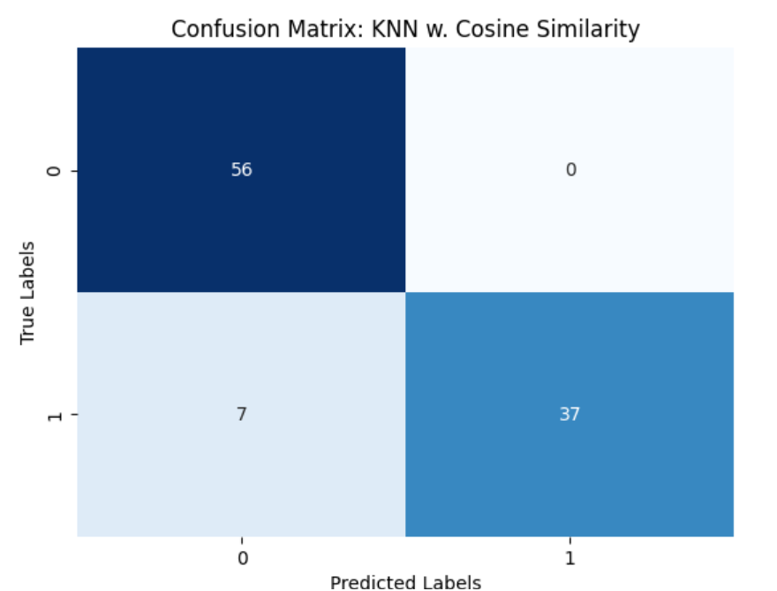
Results
Test Accuracy Scores | DistiLBERT | Word2Vec
KNN | 93% | 84%
Logistic Reg. | 96% | 93%

Slide 7




Limitations
Computational expense
Overfitting
Hard to capture nuances of specific words
Temporal limitations

Slide 8
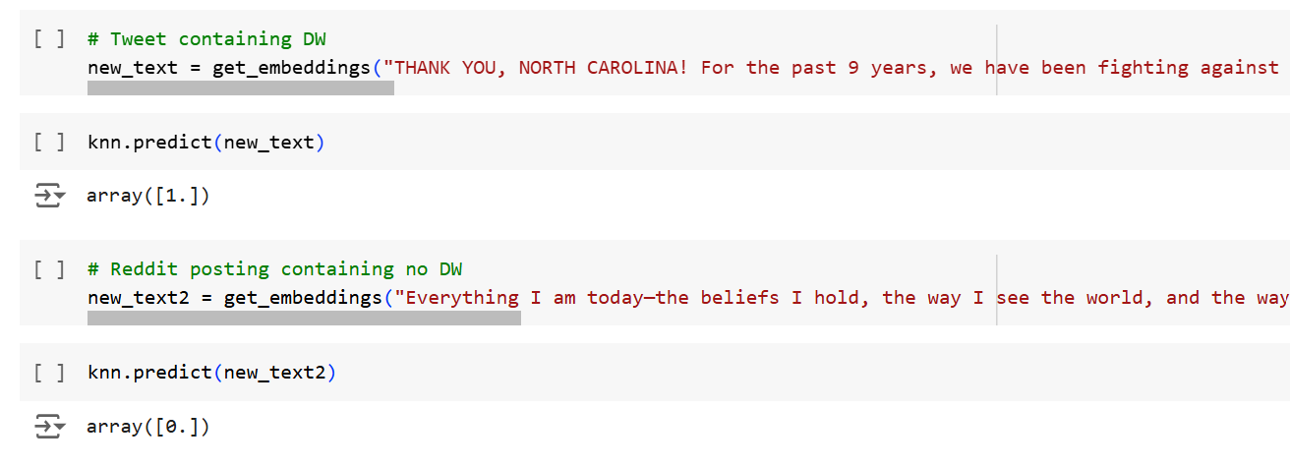
Real World Examples

Slide 9
References
DistillBERT (2024). DistilBERT Uncased. Hugging Face. Accessed October 2024. https://huggingface.co/distilbert/distilbert-base-uncased
Drakulich, Kevin et. al. (February 2020). Race and policing in the 2016 presidential election: Black lives matter, the police, and dog whistle politics. Criminology, Vol. 58(2). https://doi.org/10.1111/1745-9125.12239. https://onlinelibrary.wiley.com/doi/abs/10.1111/1745-9125.12239
Grimes, William (1992). Great “Hello” Myster is Solved. New York Times. https://www.nytimes.com/1992/03/05/garden/great-hello-mystery-is-solved.html
Glossary of Dog Whistles (2023). Association for Computational Linguistics. https://dogwhistles.allen.ai/glossary
Kruk, Jula et. al. (August 2024). Silent Signals, Loud Impact: LLMs for Word-Sense Disambiguation of Coded Dog Whistles. Association for Computational Linguistics, Vol. 1. https://aclanthology.org/2024.acl-long.675.pdf
Mendelsohn, Julia, et. Al. (July 2023). From Dogwhistles to Bullhorns: Unveiling Coded Rhetoric with Language Models. Association for Computational Linguistics, Vol. 1. https://aclanthology.org/2023.acl-long.845.pdf
Meta Research. Introducing LLaMA: A foundational, 65-billion-parameter large language model. February 24, 2023. Accessed October 14, 2024. https://ai.meta.com/blog/large-language-model-llama-meta-ai/.
Nicholson. Chris. (2023). A Beginner’s Guide to Word2Vec. Pathmind. Accessed November 2024. A Beginner's Guide to Word2Vec and Neural Word Embeddings | Pathmind
Nreimers (2024). Reddit Questions Best Answers. Hugging Face. Accessed October 2024. nreimers/reddit_question_best_answers · Datasets at Hugging Face
Reddit (2024). R/communities. Accessed November 2024. https://www.reddit.com/best/communities/1/
Sayeed, Asad et. al. (February 2024). The utility of (political) dogwhistles – a life cycle perspective. University of Gothenburg. https://doi.org/10.1075/jlp.23047.say. The utility of (political) dogwhistles – a life cycle perspective | John Benjamins (jbe-platform.com).
Silent Signals Dataset. SALT-NLP/silent_signals. HuggingFace. Accessed September 16, 2024. https://huggingface.co/datasets/SALT-NLP/silent_signals
Wetts, Rachel and Willer, Robb (August 7, 2019). Who Is Called by the Dog Whistle? Experimental Evidence That Racial Resentment and Political Ideology Condition Responses to Racially Encoded Messages. American Sociological Association, Vol. 5. https://doi.org/10.1177/2378023119866268. https://journals.sagepub.com/doi/10.1177/2378023119866268?icid=int.sj-abstract.citing-articles.15

